Slide 1

ANÁLISIS DE DATOS ESPACIALES
EDIER V. ARISTIZÁBAL G.
Ing. Geólogo (Universidad Nacional de Colombia)
Esp. en Gestión de Riesgos Geológicos (Universidad de Ginebra – Suiza)
MSc. en Geociencias (Universidad de Shimane – Japón)
PhD. en Ingeniería (Universidad Nacional de Colombia)
Universidad Nacional de Colombia
Facultad de Minas
Departamento de Geociencias

Slide 2
“There are known knowns. These are things we know that we know…
There are known unknowns. That is to say, there are things that we know we don't know…
But there are also unknown unknowns. There are things we don't know we don't know.”
Donald Rumsfeld

Slide 3
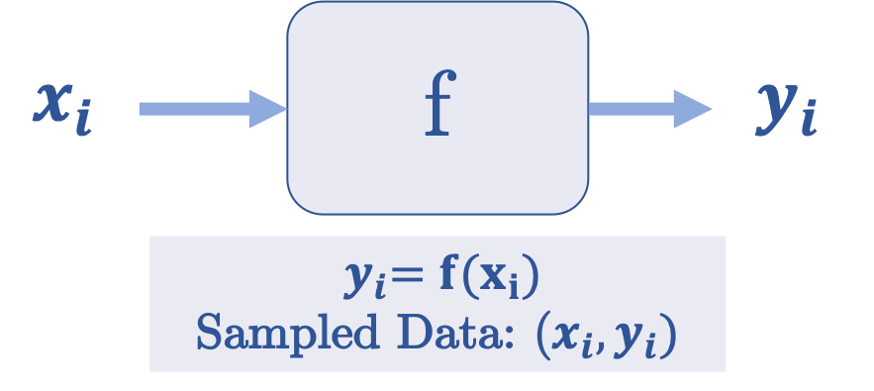
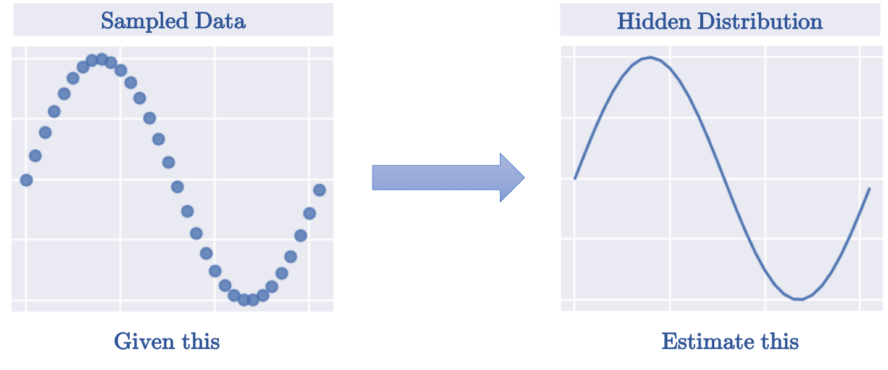

Slide 4
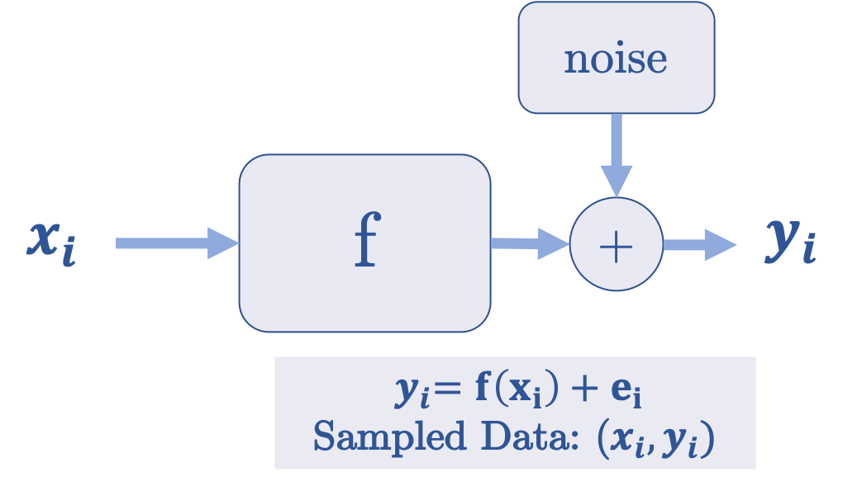
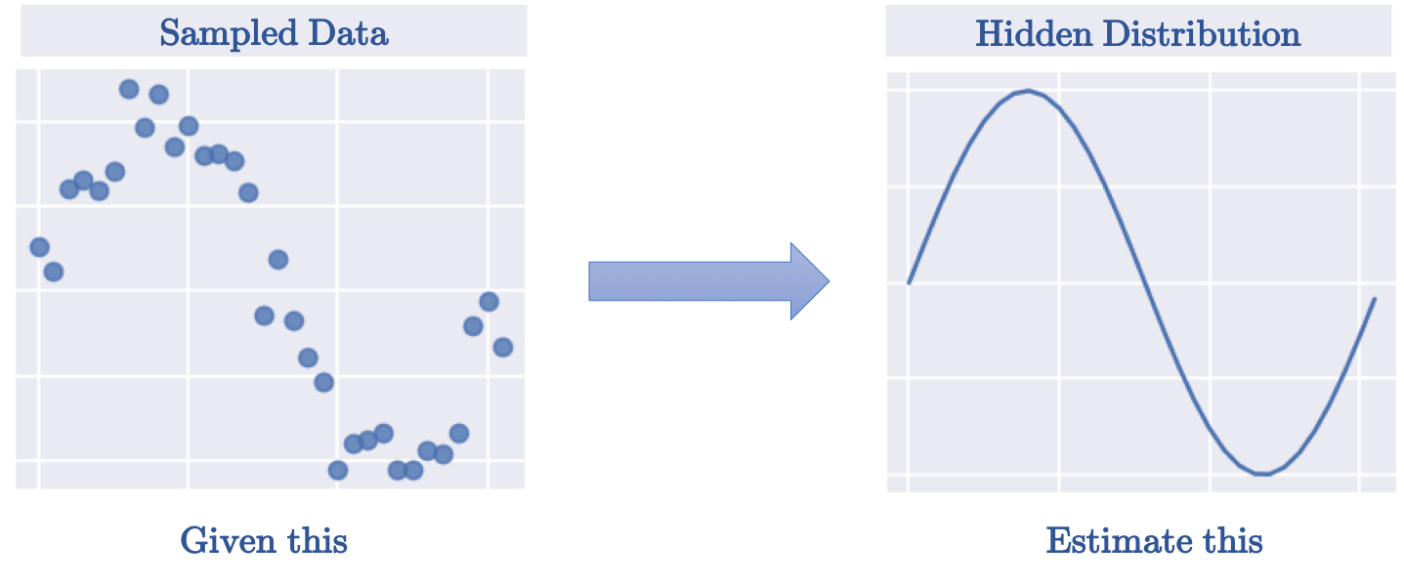

Slide 5
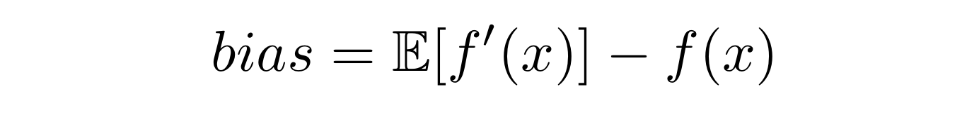
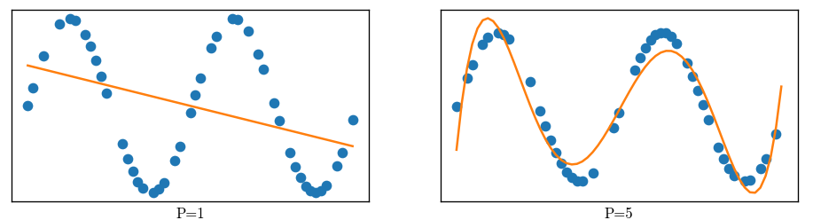
Bias is termed as the error between the average model prediction f`(x)and the ground truth f(x)

Slide 6
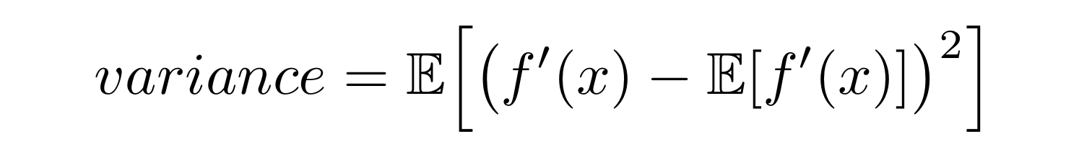
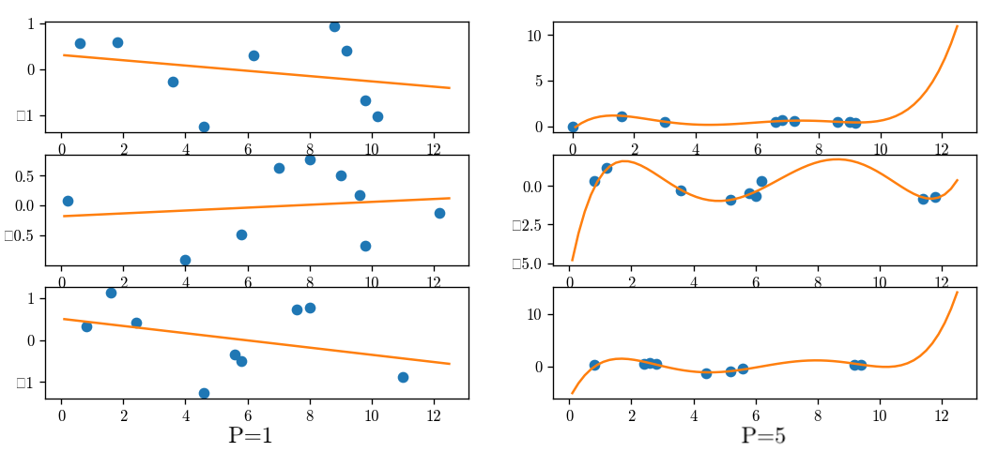

Slide 7
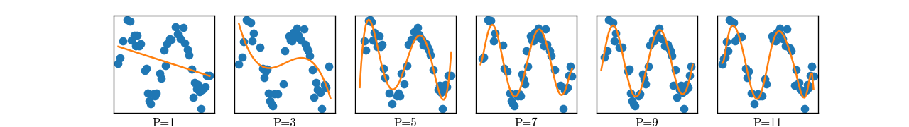
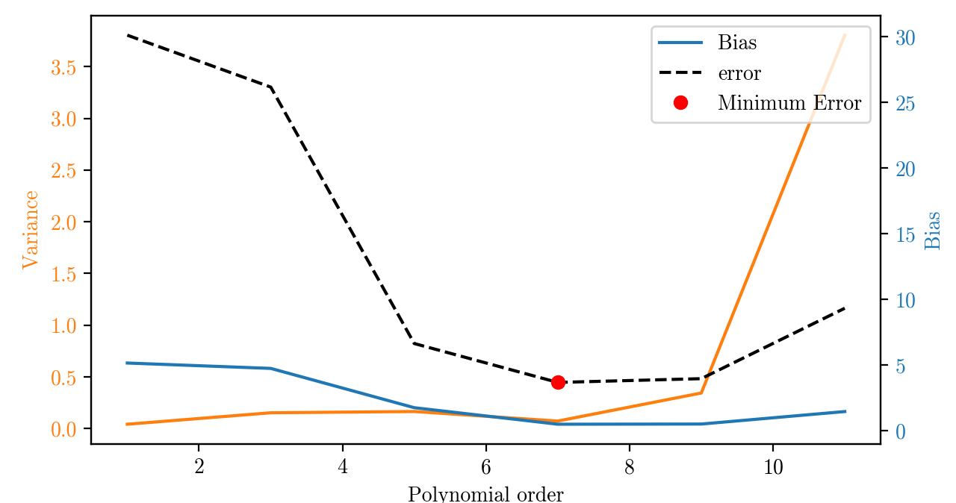

Slide 8

FUENTES DE INCERTIDUMBRE
Variabilidad natural (known unknowns)
Falta de conocimiento o datos (unknown unknowns)
Fuente: Li & Lan (2015)

Slide 9
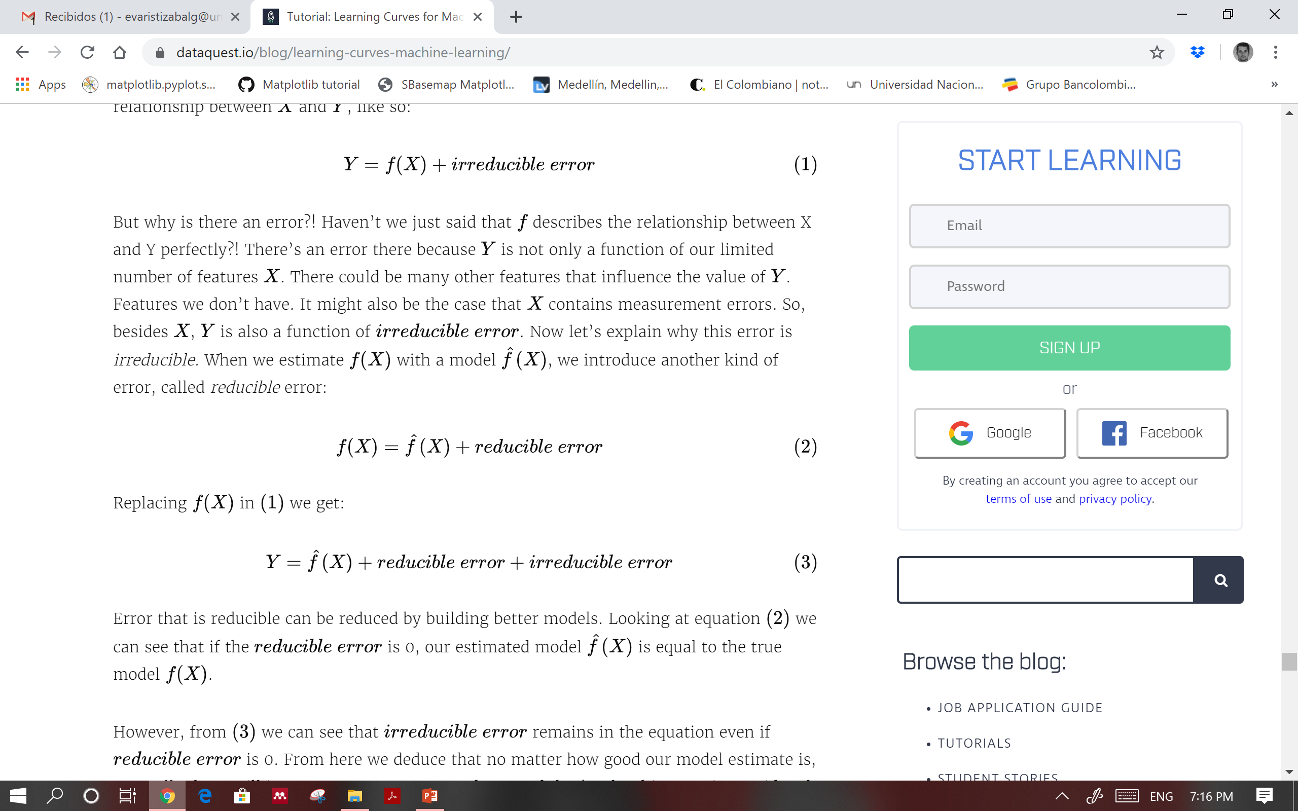
ERROR REDUCIBLE - IRREDUCIBLE
known knowns
known unknowns
unknown unknowns

Slide 10
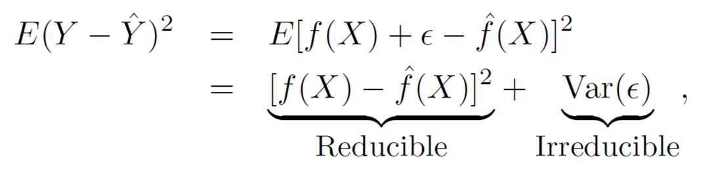
ERROR
The accuracy of Ŷ as a prediction for Y depends on two quantities, which we will call the reducible error and the irreducible error.
Reducible error. ḟ will not be a perfect estimate for f real, and this inaccuracy will introduce some error. This error is reducible because we can potentially improve the accuracy of ḟ by using the most appropriate statistical learning technique to estimate f.
Irreducible error. Our prediction would still have some error in it. This is because Ŷ is also a function of X, which, by definition, cannot be predicted using X. The quantity may contain unmeasured variables that are useful in predicting Y : since we don’t measure them, ḟ cannot use them for its prediction. The quantity may also contain unmeasurable variation.

Slide 11
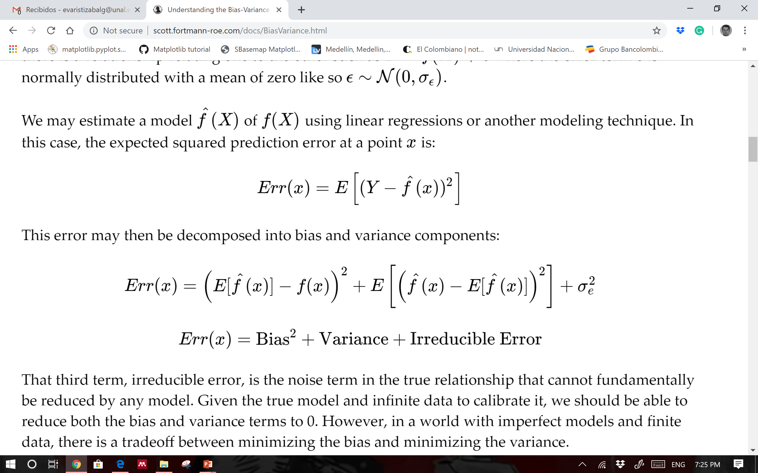
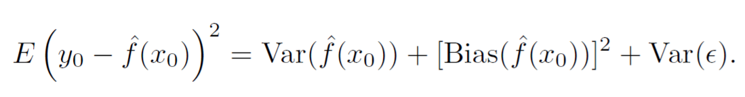
ERROR: BIAS & VARIANCE & I-ERROR

Slide 12
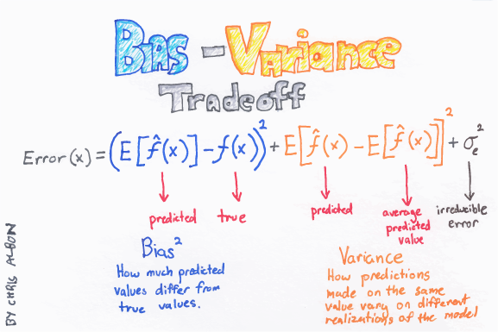

Slide 13
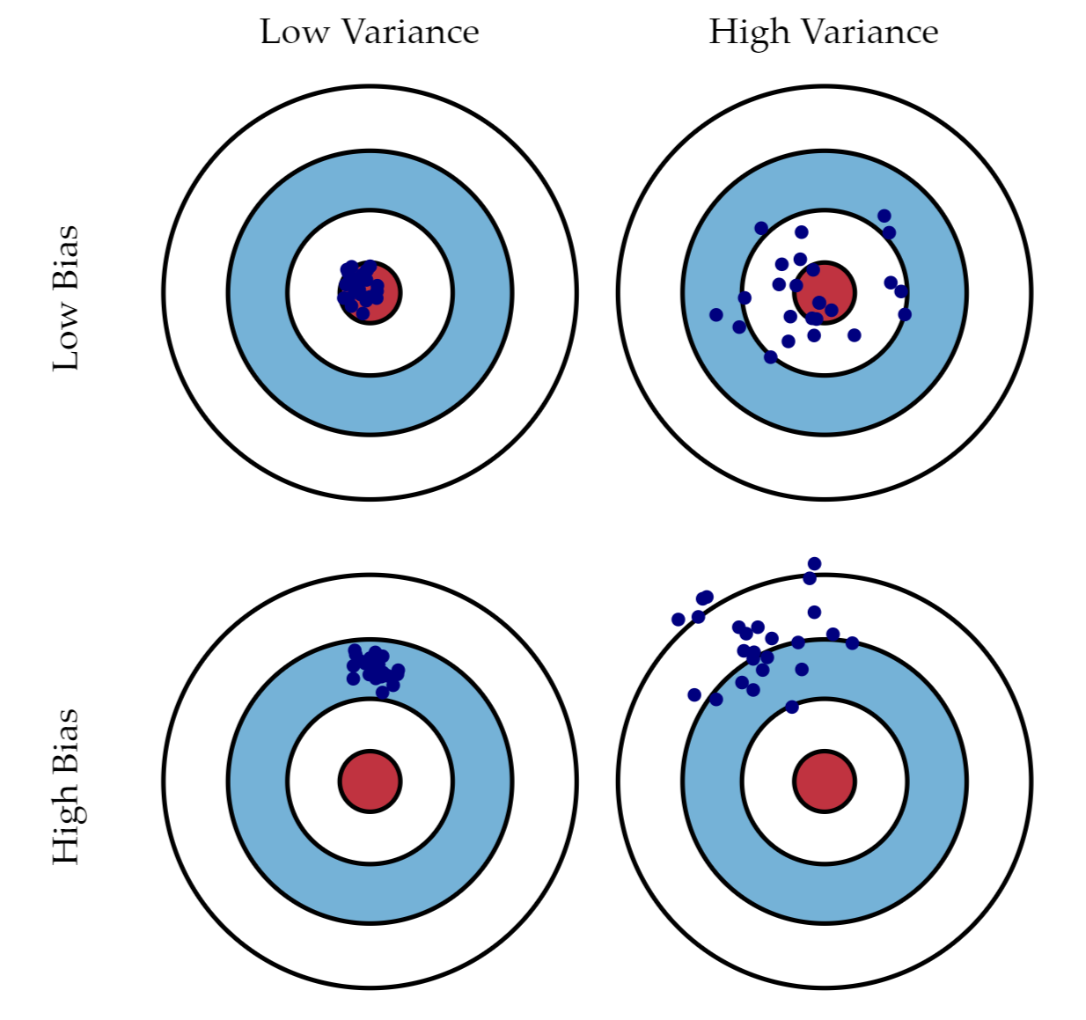
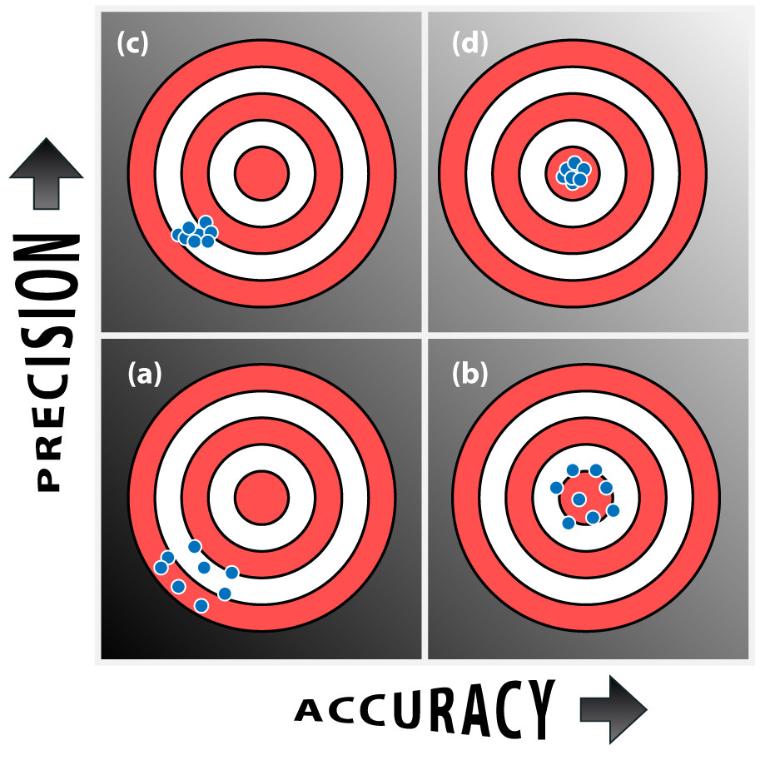
BIAS-VARIANCE TRADEOFF

Slide 14
BIAS-VARIANCE TRADEOFF
Bias is the amount of error introduced by approximating real-world phenomena with a simplified model.
Low Bias: Suggests less assumptions about the form of the target function. Decision Trees, k-NN and Support Vector Machines.
Bias: Suggests more assumptions about the form of the target function. Linear Regression, Linear Discriminant Analysis and Logistic Regression.
Variance is how much your model's test error changes based on variation in the training data. It reflects the model's sensitivity to the idiosyncrasies of the data set it was trained on.
Low Variance: Suggests small changes to the estimate of the target function with changes to the training dataset. Linear Regression, Linear Discriminant Analysis and Logistic Regression
High Variance: Suggests large changes to the estimate of the target function with changes to the training dataset. Decision Trees, k-Nearest Neighbors and Support Vector Machines.
As a model increases in complexity and it becomes more wiggly (flexible), its bias decreases (it does a good job of explaining the training data), but variance increases (it doesn't generalize as well).
Good model: low bias and low variance.

Slide 15
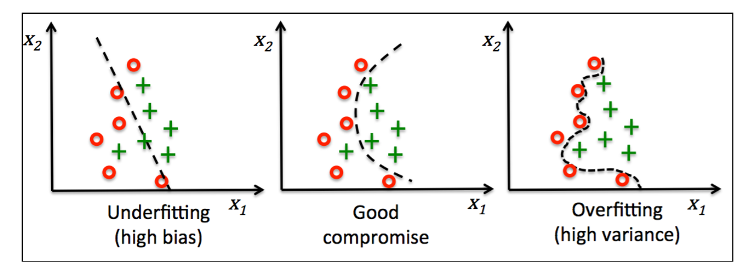
TRADE OFF BIAS - VARIANCE
High bias = underfitting
High variance = overfitting

Slide 16
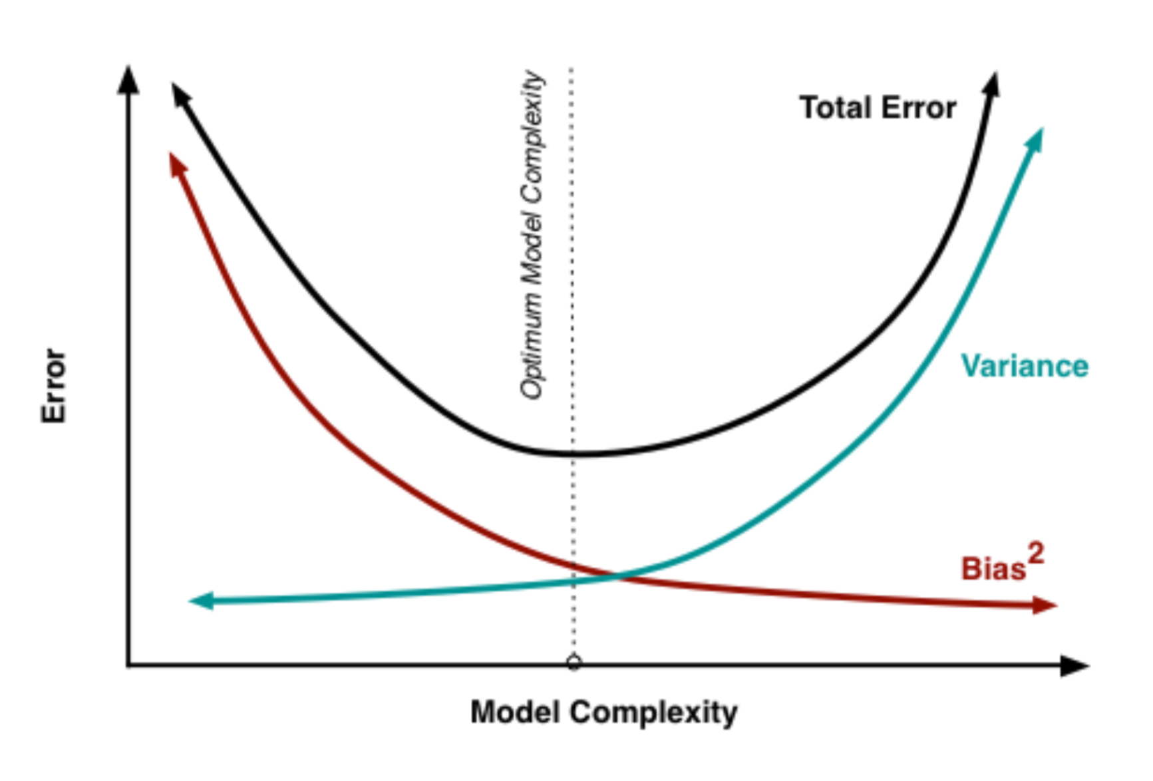
TRADE OFF BIAS - VARIANCE

Slide 17

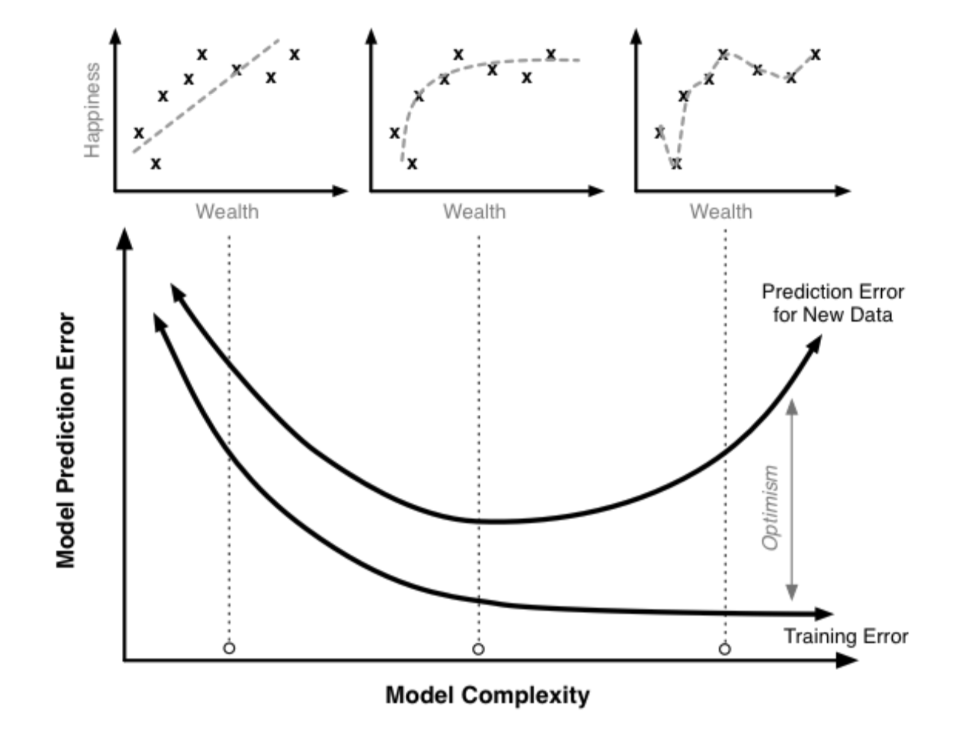
CURVA DE APRENDIZAJE

Slide 18
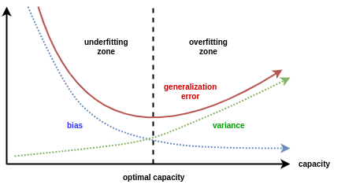
TRADE OFF BIAS - VARIANCE

Slide 19
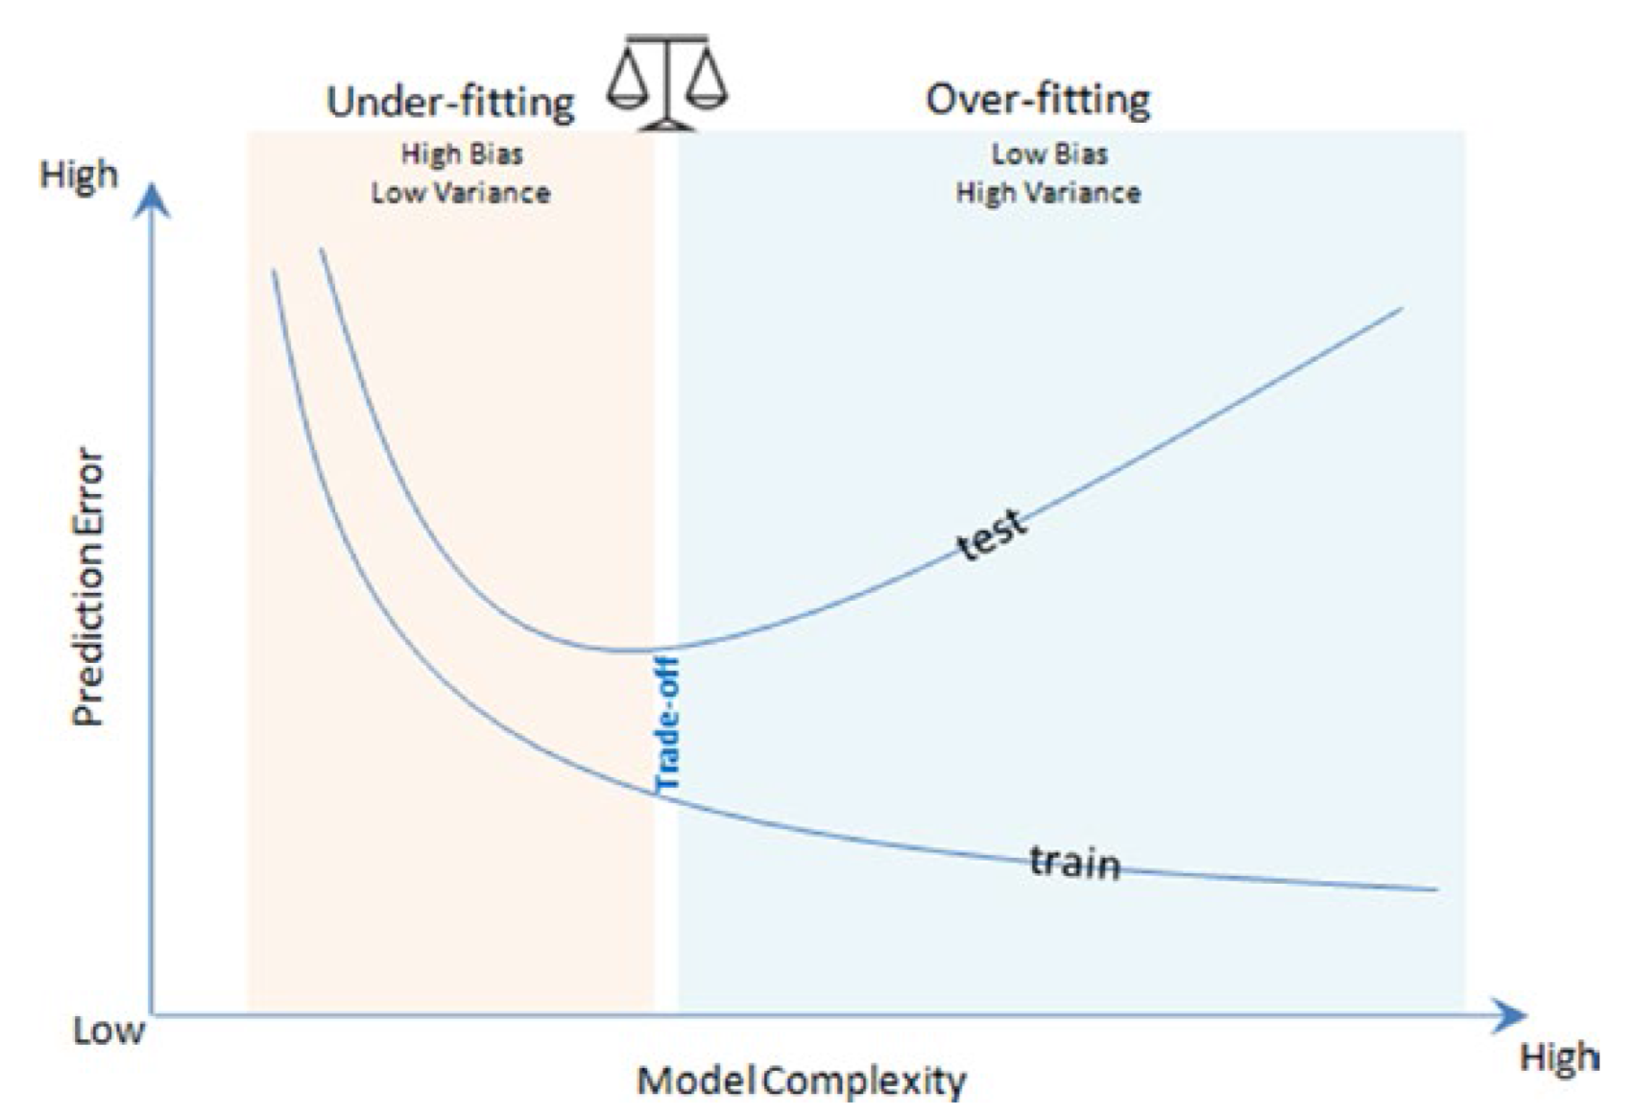
TRADE OFF BIAS - VARIANCE

Slide 20
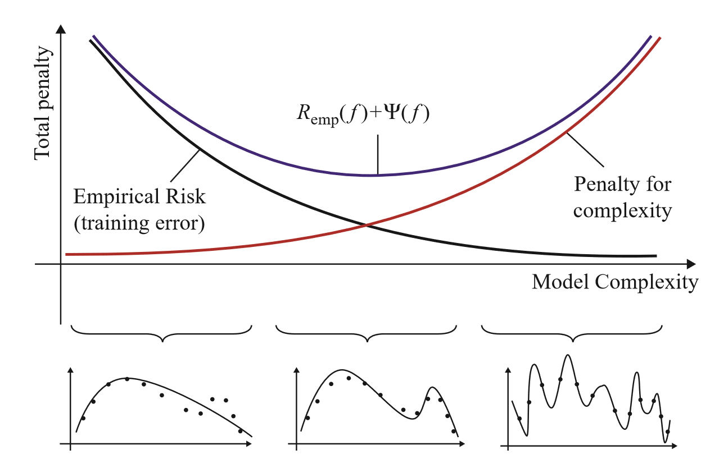
TRADE OFF BIAS - VARIANCE

Slide 21
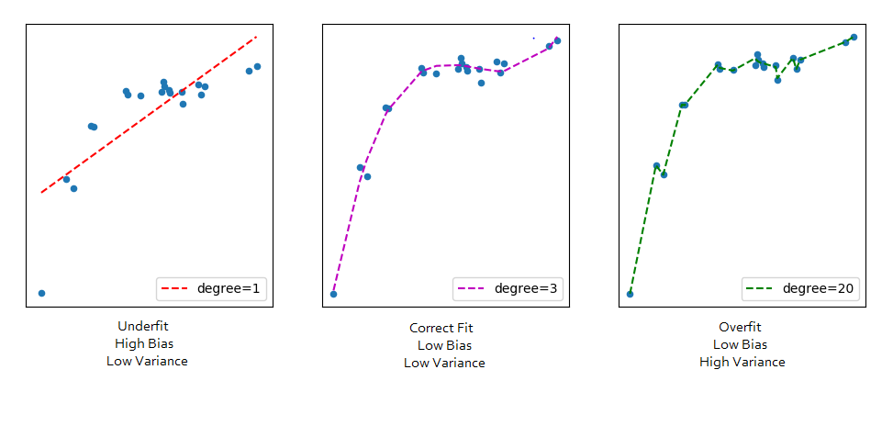
TRADE OFF BIAS - VARIANCE

Slide 22
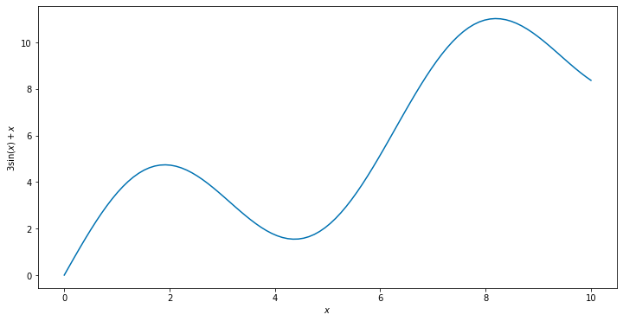
y without the noise
https://towardsdatascience.com/understanding-the-effect-of-bagging-on-variance-and-bias-visually-6131e6ff1385

Slide 23
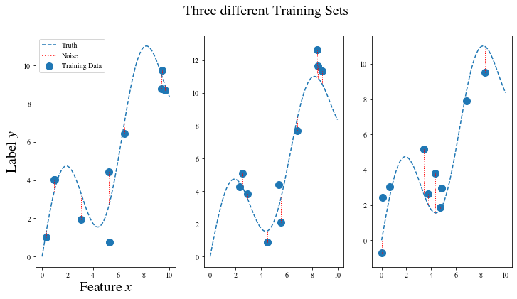
Sampling from the distribution three times yields 3 different results. Each time 10 training samples were generated.
https://towardsdatascience.com/understanding-the-effect-of-bagging-on-variance-and-bias-visually-6131e6ff1385

Slide 24
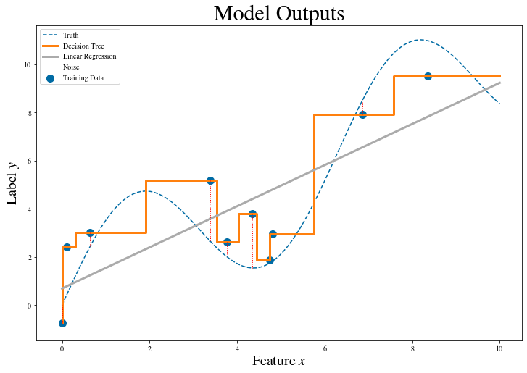
We can see that the Decision Tree fits the training data perfectly, which is not a reason to celebrate, however. The problem is that the algorithm also captures the noise, which we do not want. We are only interested in capturing the underlying structure of the labels (namely 3sin(x)+x), instead.
https://towardsdatascience.com/understanding-the-effect-of-bagging-on-variance-and-bias-visually-6131e6ff1385

Slide 25
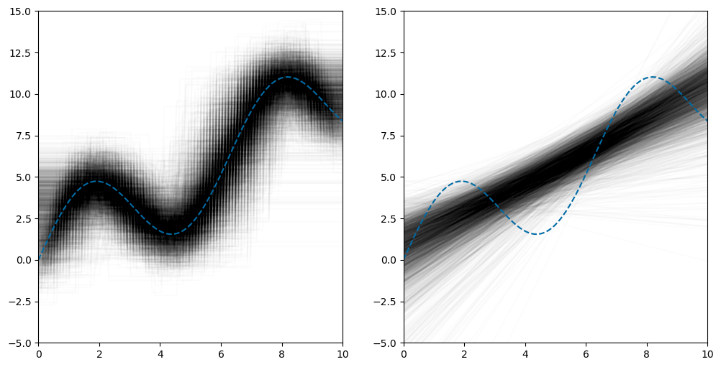
Let us conduct the same experiment 3000 times for 3000 independently sampled training sets, each of size 10 again. On the left side, we see the results of the Decision Trees and on the right side, there are the Linear Regression results stacked on top of each other.
Each trial gives one curve in transparent black. The more lines stack, the darker the intersections get. The dashed blue line is 3sin(x)+x again, the underlying truth
https://towardsdatascience.com/understanding-the-effect-of-bagging-on-variance-and-bias-visually-6131e6ff1385

Slide 26
Here we can see that the Decision Trees (left side) fit the data quite well on average. People also refer to this property as Decision Trees having a low bias. Meanwhile, for Linear Regression on the right side, the model clearly can not capture the complex pattern of the underlying label structure. We say that Linear Regression has high bias, in this case, it is not able to learn the truth.
https://towardsdatascience.com/understanding-the-effect-of-bagging-on-variance-and-bias-visually-6131e6ff1385

Slide 27
Yet, if you consider the vertical width of these black tubes, the ones stemming from the Decision Trees are wider than the Linear Regression ones on the right. This means that the Decision Tree predictions wiggle around more extremely than the Linear Regression predictions when re-sampling the training dataset, which we refer to as Decision Trees having a high variance and Linear Regression having a low variance
https://towardsdatascience.com/understanding-the-effect-of-bagging-on-variance-and-bias-visually-6131e6ff1385

Slide 28
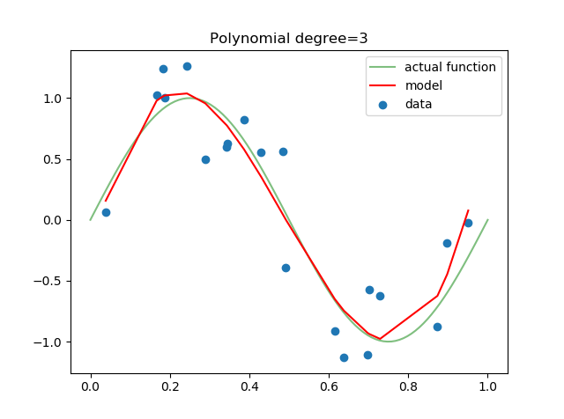
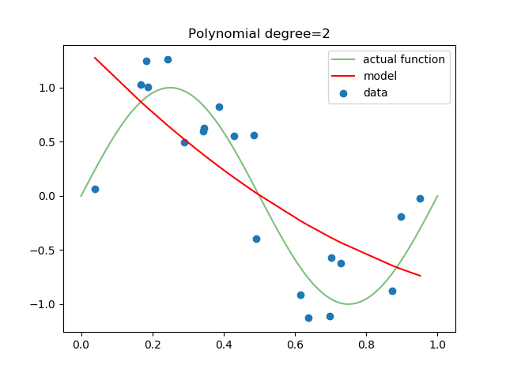
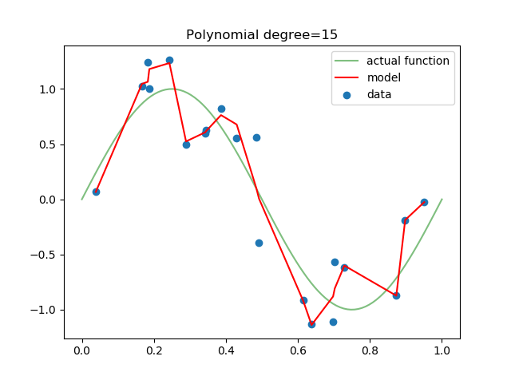
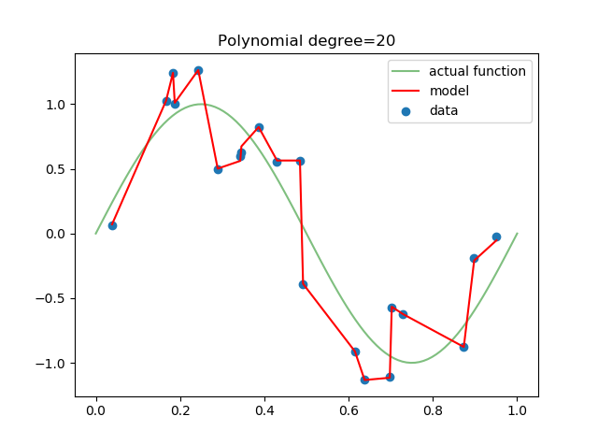
UNDERFITTING vs OVERFITTING

Slide 29
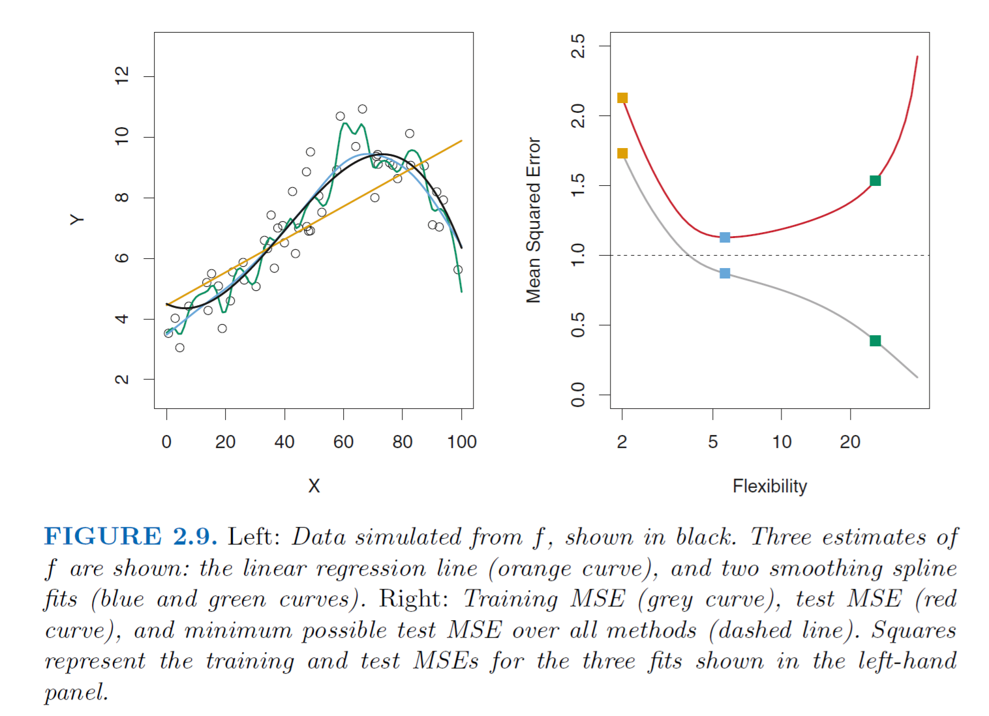
MEJOR FUNCIÓN Y POR QUÉ?

Slide 30
COMO RESOLVERLO?
Features:
Having too many features may introduce high variance and results in overfitting.
Although Regularization helps in reducing the importance of features, it is always a good idea to review the importance of features using Exploratory Data Analysis (EDA) or by using domain knowledge.
If a feature is adding little value in predicting the dependent variable it makes sense not to use that feature.
On the other hand, if the model is underfitting, it means that the model is not learning enough to fit sufficient number of points by finding the right hyperplane. In such a scenario, more features should be added in the model.

Slide 31
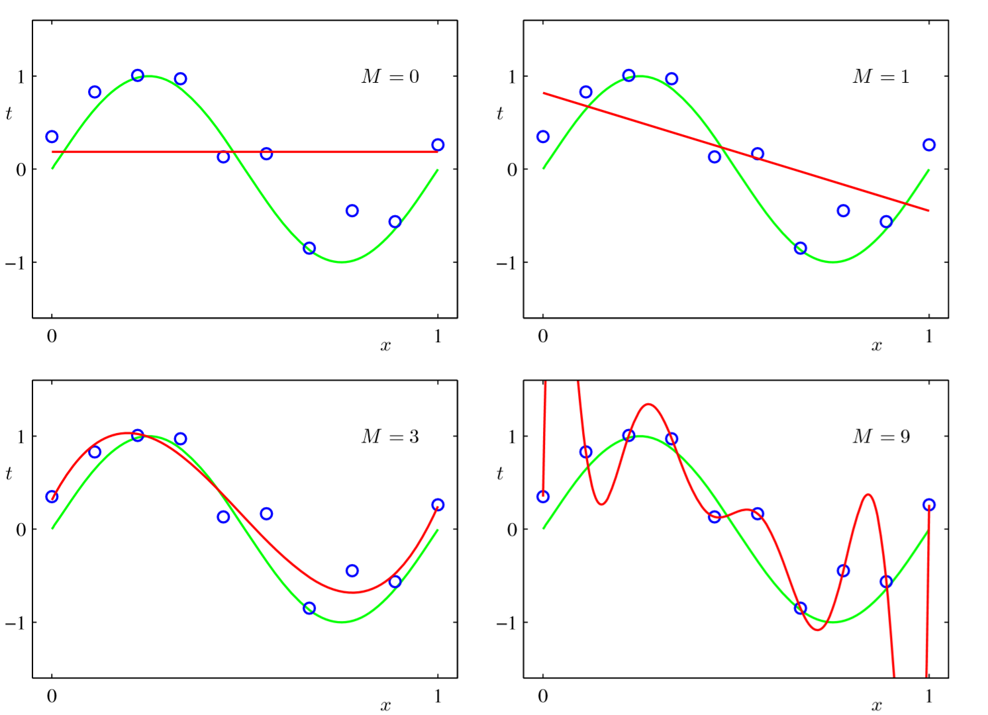
COMO RESOLVERLO?

Slide 32
COMO RESOLVERLO?
Number of Training Records:
Increasing the number of training records generally tends to help reduce Variance.
However, it also depends on the quality of data. For example, if the test data has some particular type of data which is not at all present in training data then overfitting is bound to happen because the model has not learnt a particular type of data in the training. In such a case, if we just add more data records in training data but do not add the type of data which was actually missing from the training dataset earlier, then this would not help in reducing variance.
If the model is having high bias, then adding data does not help beyond a certain point. The training error remains almost constant after certain point as we increase the number of training records.

Slide 33
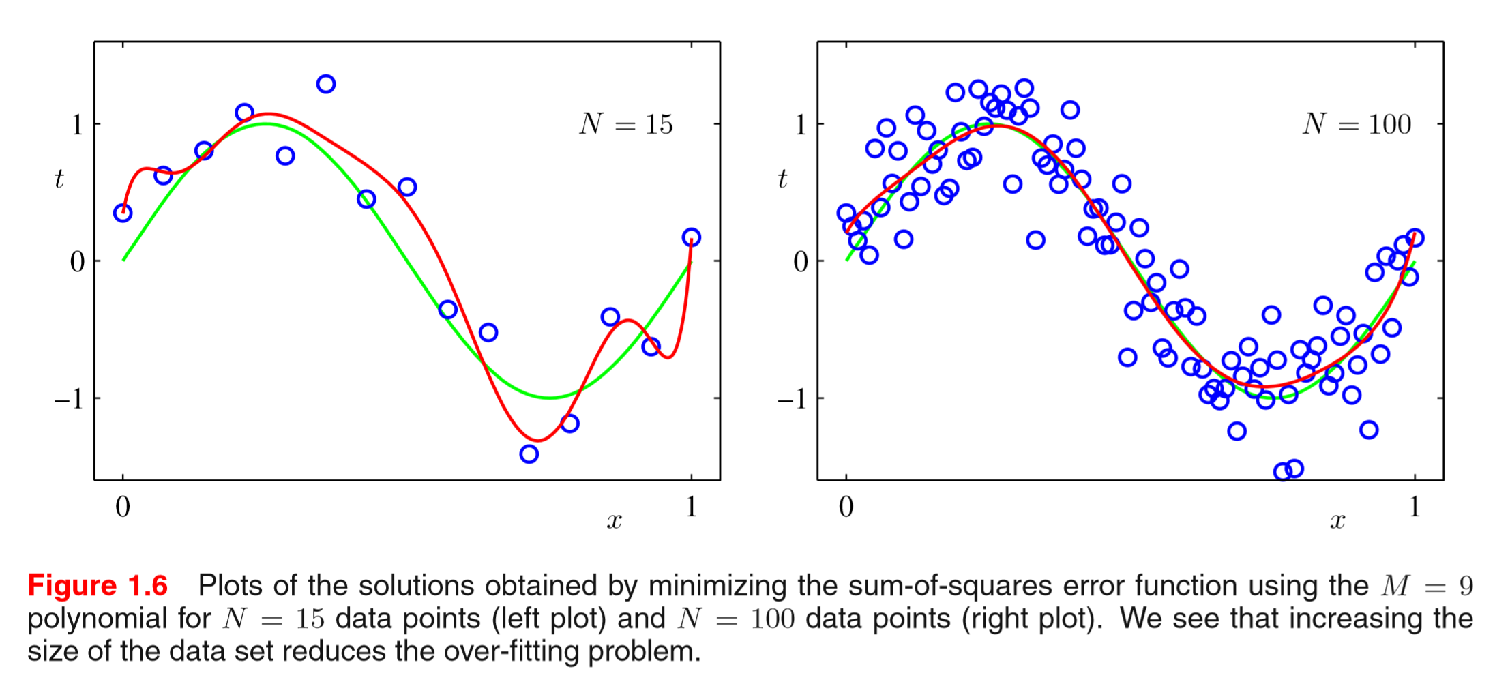
COMO RESOLVERLO?

Slide 34
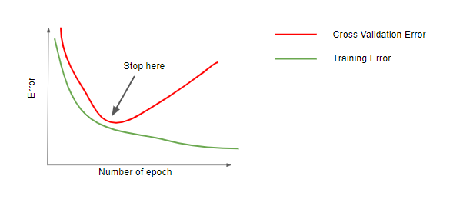
COMO RESOLVERLO?
Early Stopping:
Early stopping is another way to avoid overfitting. Early stopping is used in Neural Network and Tree based algorithms. As shown in the graph below, in Neural networks it may happen that the difference between the training error and cross validation error reduces as the number of epochs increases. It reaches its minimum value on certain epoch and then increases in subsequent epochs. In early stopping, we stop the algorithm on the epoch (or the next epoch) showing minimum difference between train and cross validation error.

Slide 35
COMO RESOLVERLO?
Early Stopping:
In Decision trees, the variance increases as the depth of the tree increases. To make sure we don’t overfit, the growth of the decision tree is stopped at the optimum depth. This is typically achieved in two ways. First is stopping the tree growth if the number of data points at a node (i.e. number of data points satisfying the condition on the node) is less than some specific threshold value. In this case, having too few number of data points on a sample indicate that the tree might be picking up some noisy points or outliers. The second way is to stop the growth of the tree at length which gives minimum cross validation error.

Slide 36
COMO RESOLVERLO?
Choice of Machine Learning Algorithm:
Bias -Variance trade-off can be controlled using regularization and other means in all machine learning algorithms. However, some ML algorithms such as Deep Neural networks, tend to overfit more. This is because, Deep Neural networks are typically used in applications having huge number of features (e.g. Computer Vision).
Bagging (Random Forest) and Boosting (Gradient Boosted Decision Trees) are algorithms that inherently reduce Variance and Bias respectively. In Random Forest, the base learners (Decision Trees) are of higher depth which make the base learners more prone to overfitting (i.e. high variance) but because of the Randomization, the overall variance on the aggregate level reduces significantly. On the other hand, Boosting algorithms such as Gradient Boosted Decision Trees (GBDT) use shallow base learners which are more prone to underfitting (i.e. high bias) but it reduces the bias on aggregate level by sequentially adding and training simple (shallow decision trees with less complexity) base learners.

Slide 37
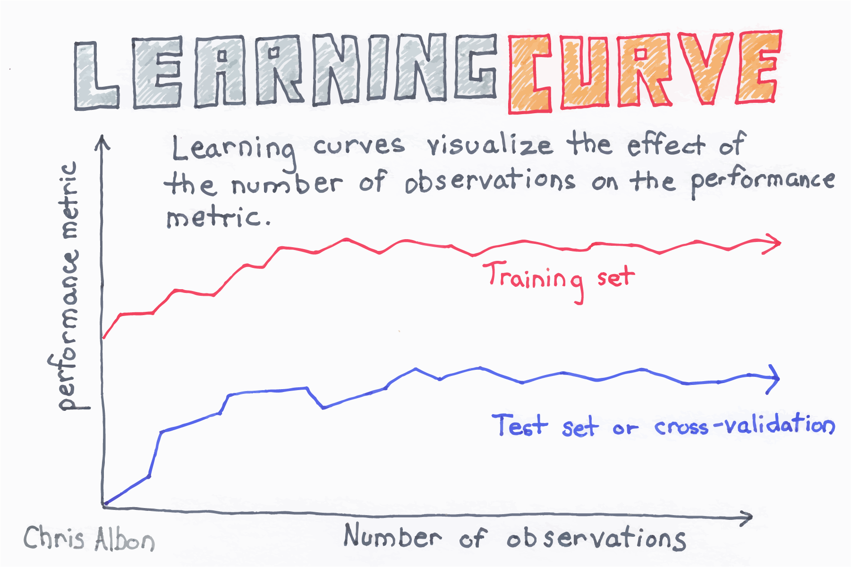
COMO HACERLO?

Slide 38
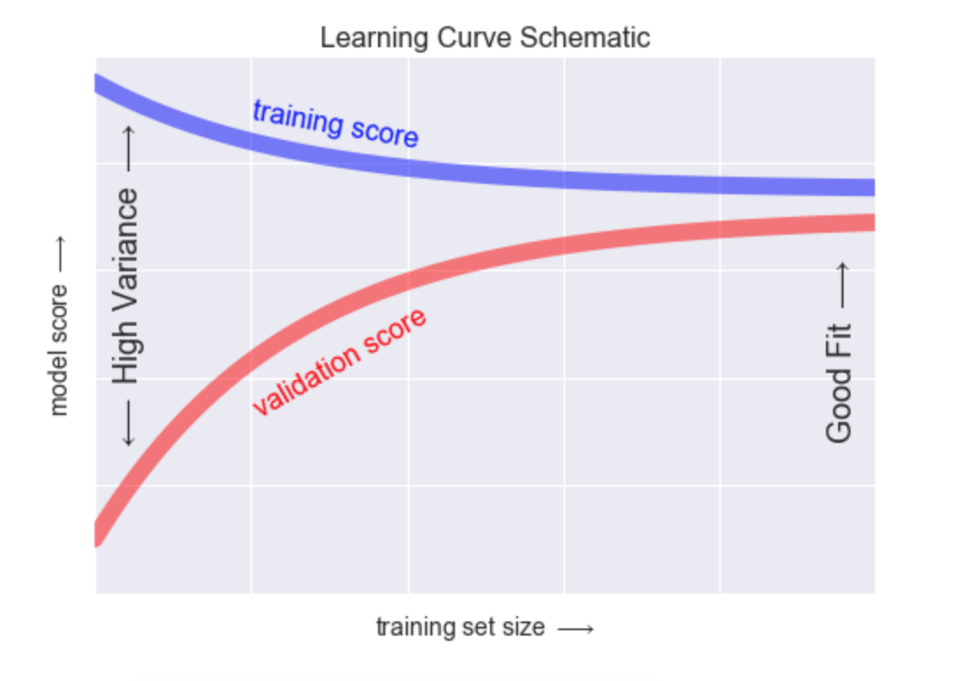
COMO HACERLO?...Curvas de Aprendizaje
A learning curve shows the performance or classification error of a classifier as a function of the size of the training set.

Slide 39
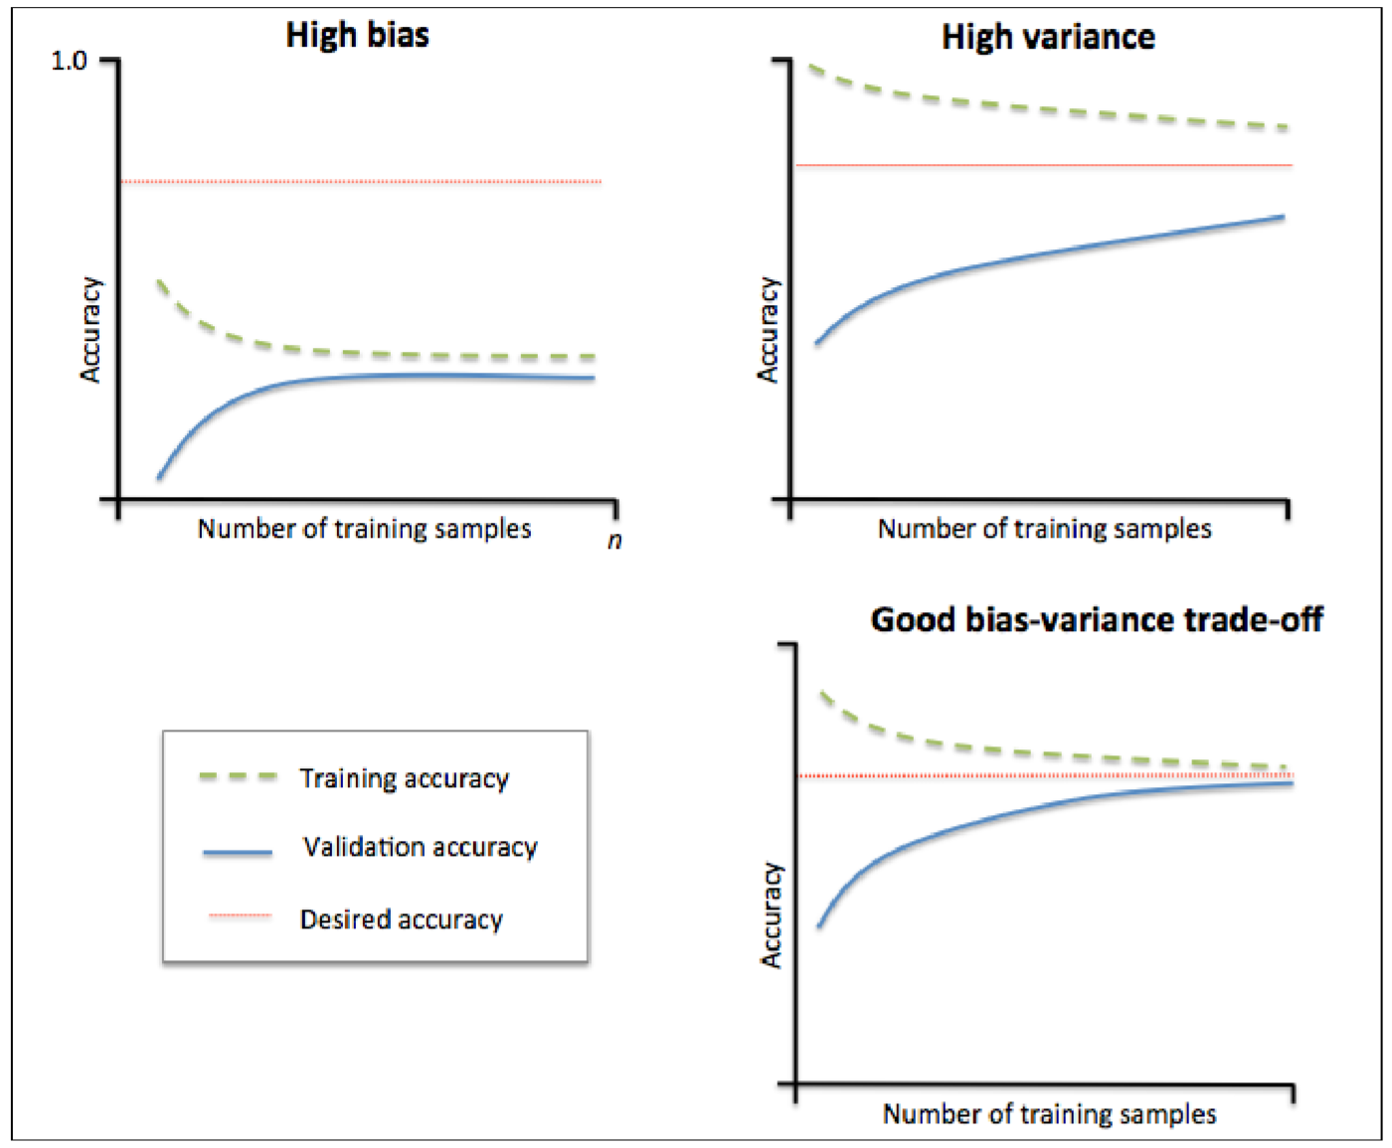


CURVAS DE APRENDIZAJE

Slide 40
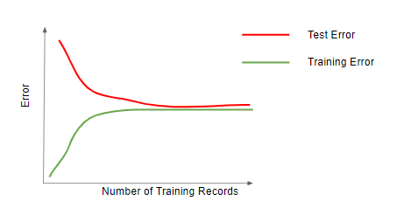

CURVAS DE APRENDIZAJE
En términos de error….

Slide 41
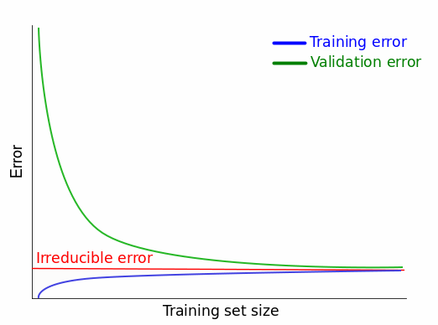
CURVAS DE APRENDIZAJE
En términos de error….

Slide 42
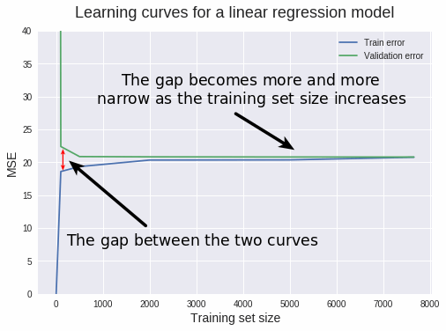
CURVAS DE APRENDIZAJE

Slide 43
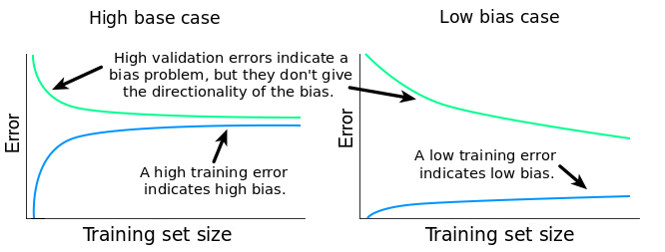
CURVAS DE APRENDIZAJE

Slide 44
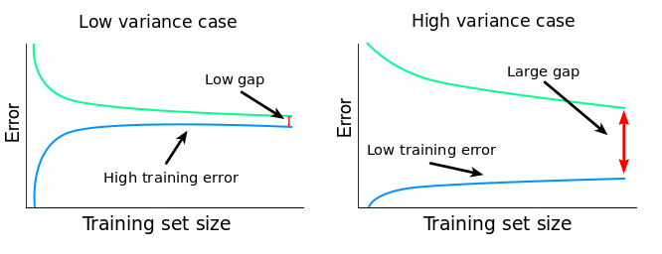
CURVAS DE APRENDIZAJE

Slide 45
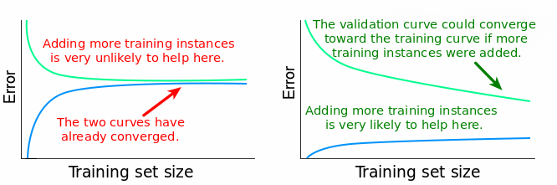
CURVAS DE APRENDIZAJE

Slide 46
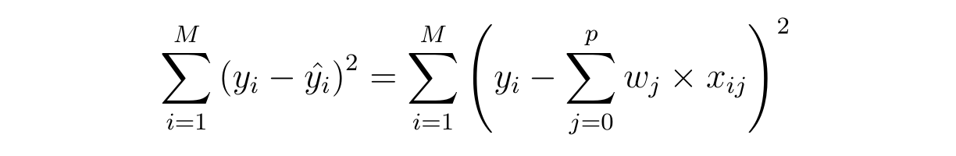
FUNCIÓN DE COSTO
In mathematical optimization and decision theory, a loss function or cost function is a function that maps an event or values of one or more variables onto a real number intuitively representing some "cost" associated with the event. An optimization problem seeks to minimize a loss function. An objective function is either a loss function or its negative (in specific domains, variously called a reward function, a profit function, a utility function, a fitness function, etc.), in which case it is to be maximized.
In statistics, typically a loss function is used for parameter estimation, and the event in question is some function of the difference between estimated and true values for an instance of data.

Slide 47
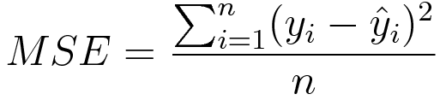
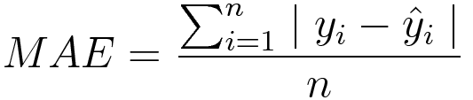
FUNCIÓN DE COSTO: REGRESIÓN
They are used in case of regressive problems, that is when the target variable is continuous. Most widely used regressive loss function is Mean Square Error. Other loss functions are:
1. Absolute error — measures the mean absolute value of the element-wise difference between input;
2. Smooth Absolute Error — a smooth version of Abs Criterion.
Mean Square Error/Quadratic Loss/L2 Loss
Mean Absolute Error/L1 Loss

Slide 48
FUNCIÓN DE COSTO: CLASIFICACIÓN
The output variable in classification problem is usually a probability value f(x), called the score for the input x. Generally, the magnitude of the score represents the confidence of our prediction. The target variable y, is a binary variable, 1 for true and -1 for false.
Some classification algorithms are:
1. Binary Cross Entropy
2. Negative Log Likelihood
3. Margin Classifier
4. Soft Margin Classifier
Cross Entropy Loss/Negative Log Likelihood

Slide 49
FUNCIÓN DE COSTO
Mean Squared Error
Mean Squared Error (MSE) is the workhorse of basic loss functions: it’s easy to understand and implement and generally works pretty well. To calculate MSE, you take the difference between your predictions and the ground truth, square it, and average it out across the whole dataset.
Likelihood Loss
The likelihood function is also relatively simple, and is commonly used in classification problems. The function takes the predicted probability for each input example and multiplies them. And although the output isn’t exactly human interpretable, it’s useful for comparing models.
For example, consider a model that outputs probabilities of [0.4, 0.6, 0.9, 0.1] for the ground truth labels of [0, 1, 1, 0]. The likelihood loss would be computed as (0.6) * (0.6) * (0.9) * (0.9) = 0.2916. Since the model outputs probabilities for TRUE (or 1) only, when the ground truth label is 0 we take (1-p) as the probability. In other words, we multiply the model’s outputted probabilities together for the actual outcomes.

Slide 50
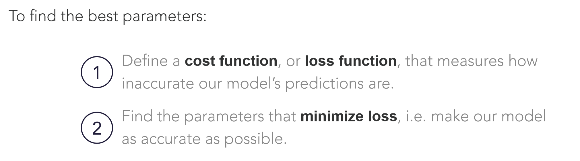
FUNCIÓN DE OPTIMIZACIÓN
Gradually, with the help of some optimization function, loss function learns to reduce the error in prediction. An optimization algorithm is a procedure which is executed iteratively by comparing various solutions until an optimum or a satisfactory solution is found. ... These algorithms minimize or maximize a Loss function E(x) using its Gradient values with respect to the parameters.

Slide 51

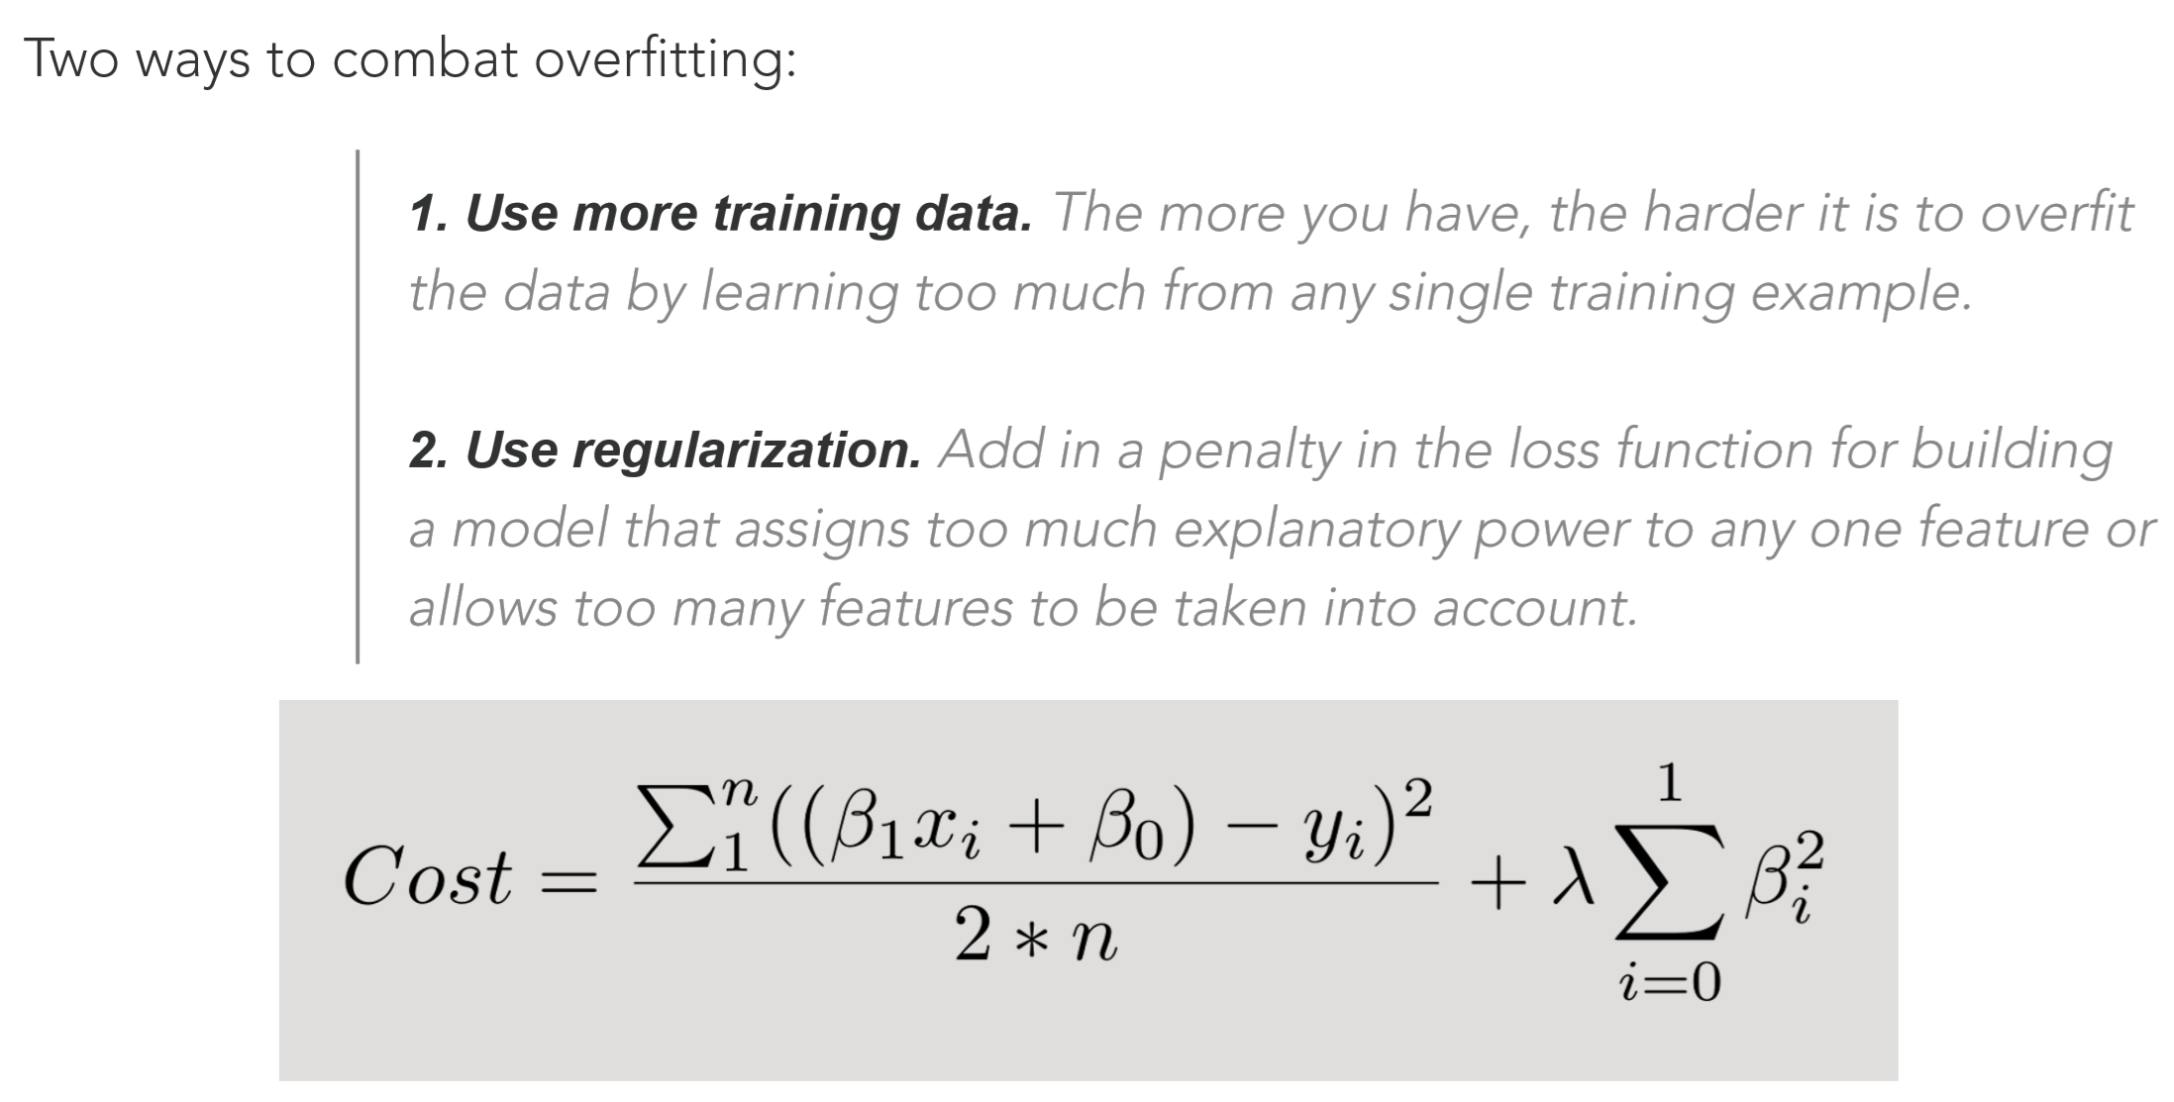


PENALIZED LINEAR REGRESSION
Ridge (L2)
Lasso (L1)
Regularization essentially reduces the complexity in the model either by getting rid of the complex features or reducing their importance. Mathematically, the term complexity refers to features represented by higher degree polynomials in the Regression equation. Reducing the importance of higher degree polynomials results in making the relationship curve between a feature and the predicted variable smoother thereby increasing generalization. This is depicted in below diagram.

Slide 52

REGULARIZACIÓN
As shown in the above graphs, Without Regularization, the model has tried to accommodate almost every data point in the training data. This means that the model is being too specific. It also implies that the model has a very low training error because almost all the points are falling on the curve line. However, if this model is tested on the test data, there is a possibility that many points will not fall on the curve because the model is not generic enough. Therefore, a small change in the input data (i.e. difference between train and test data) will impact performance of the model. Thus, the model has high variance and model will result in overfitting (low training error and high test error).

Slide 53
FUNCIÓN CONVEXA

Slide 54


Slide 55

GRADIENT DESCENT
It is an optimization algorithm to find the minimum of a function. We start with a random point on the function and move in the negative direction of the gradient of the function to reach the local/global minima.

Slide 56

GRADIENT DESCENT -- Problemas
“ Houston, …we´ve had a problema”

Slide 57
GRADIENT DESCENT
The function is f(β0,β1) = z. To begin gradient descent, you make some guess of the parameters β0 and β1 that minimize the function.
Next, you find the partial derivatives of the loss function with respect to each beta parameter: [dz/dβ0, dz/dβ1]. A partial derivative indicates how much total loss is increased or decreased if you increase β0 or β1 by a very small amount.
Put another way, how much would increasing your estimate of annual income assuming zero higher education (β0) increase the loss (i.e. inaccuracy) of your model? You want to go in the opposite direction so that you end up walking downhill and minimizing loss.
Similarly, if you increase your estimate of how much each incremental year of education affects income (β1), how much does this increase loss (z)? If the partial derivative dz/β1 is a negative number, then increasing β1 is good because it will reduce total loss. If it’s a positive number, you want to decrease β1. If it’s zero, don’t change β1 because it means you’ve reached an optimum.
Keep doing that until you reach the bottom, i.e. the algorithm converged and loss has been minimized. There are lots of tricks and exceptional cases beyond the scope of this series, but generally, this is how you find the optimal parameters for your parametric model.

Slide 58


GRADIENT DESCENT → learning step
Looking for a perfect learning rate is a very important task as it depends on how large of a step we take downhill during each iteration. If we take too large of a step, we may step over the minimum. However, if we take small steps, it will require many iterations to arrive at the minimum.

Slide 59

GRADIENT DESCENT → learning step

Slide 60

GRADIENT DESCENT → learning step

Slide 61

GRADIENT DESCENT
Question : Find the local minima of the function y=(x+5)² starting from the point x=3

Slide 62
GRADIENT DESCENT
Solution : We know the answer just by looking at the graph. y = (x+5)² reaches it’s minimum value when x = -5 (i.e when x=-5, y=0). Hence x=-5 is the local and global minima of the function.
Now, let’s see how to obtain the same numerically using gradient descent.
Step 1 : Initialize x =3. Then, find the gradient of the function, dy/dx = 2*(x+5).
Step 2 : Move in the direction of the negative of the gradient (Why?). But wait, how much to move? For that, we require a learning rate. Let us assume the learning rate → 0.01
Step 3 : Let’s perform 2 iterations of gradient descent

Slide 63

GRADIENT DESCENT

Slide 64

GRADIENT DESCENT
Step 4 : We can observe that the X value is slowly decreasing and should converge to -5 (the local minima). However, how many iterations should we perform?
Let us set a precision variable in our algorithm which calculates the difference between two consecutive “x” values . If the difference between x values from 2 consecutive iterations is lesser than the precision we set, stop the algorithm !

Slide 65

GRADIENT DESCENT

Slide 66

GRADIENT DESCENT

Slide 67

GRADIENT DESCENT

Slide 68

GRADIENT DESCENT

Slide 69

GRADIENT DESCENT

Slide 70

GRADIENT DESCENT

Slide 71

GRADIENT DESCENT

Slide 72

GRADIENT DESCENT

Slide 73

GRADIENT DESCENT

Slide 74

GRADIENT DESCENT

Slide 75

GRADIENT DESCENT

Slide 76

GRADIENT DESCENT

Slide 77

GRADIENT DESCENT

Slide 78

GRADIENT DESCENT

Slide 79

GRADIENT DESCENT

Slide 80

GRADIENT DESCENT

Slide 81

GRADIENT DESCENT

Slide 82

GRADIENT DESCENT

Slide 83

GRADIENT DESCENT

Slide 84

GRADIENT DESCENT

Slide 85

GRADIENT DESCENT

Slide 86

STOCHASTIC GRADIENT DESCENT

Slide 87

STOCHASTIC GRADIENT DESCENT
Stochastic Gradient Descent (SGD) is a simple yet very efficient approach to discriminative learning of linear classifiers under convex loss functions such as (linear) Support Vector Machines and Logistic Regression.

Slide 88

Entropy is a measure of the uncertainty associated with a given distribution q(y).
entropy of a distribution, like our q(y), using the formula below, where C is the number of classes:
So, if we know the true distribution of a random variable, we can compute its entropy. But, if that’s the case, why bother training a classifier in the first place? After all, we KNOW the true distribution…
But, what if we DON’T? Can we try to approximate the true distribution with some other distribution, say, p(y)? Sure we can! :-)…Cross-Entropy

Slide 89


Cross-Entropy
Let’s assume our points follow this other distribution p(y). But we know they are actually coming from the true (unknown) distribution q(y), right?
If we compute entropy like this, we are actually computing the cross-entropy between both distributions:
If we, somewhat miraculously, match p(y) to q(y) perfectly, the computed values for both cross-entropy and entropy will match as well.
Since this is likely never happening, cross-entropy will have a BIGGER value than the entropy computed on the true distribution.

Slide 90

Kullback-Leibler Divergence
The Kullback-Leibler Divergence,or “KL Divergence” for short, is a measure of dissimilarity between two distributions:
This means that, the closer p(y) gets to q(y), the lower the divergence and, consequently, the cross-entropy, will be.
So, we need to find a good p(y) to use… but, this is what our classifier should do, isn’t it?! And indeed it does! It looks for the best possible p(y), which is the one that minimizes the cross-entropy.

Slide 91



Loss Function
During its training, the classifier uses each of the N points in its training set to compute the cross-entropy loss, effectively fitting the distribution p(y)! Since the probability of each point is 1/N, cross-entropy is given by:

Slide 92

CROSS ENTROPY / LOG LOSS
Loss funtion for binary classification
Cuando la clase es igual a 1 (y=1) adicional la log probabilidad de que sea 1
log (p(y))
= 0
Cuando la clase es cero (y=0) adiciona la log probabilidad que sea 0
= 0
log (1 – p(y))

Slide 93


CROSS ENTROPY / LOG LOSS

Slide 94

CROSS ENTROPY / LOG LOSS
Logistic regression

Slide 95


CROSS ENTROPY / LOG LOSS
Predicted probabilities = 1
Predicted probabilities = 0

Slide 96


CROSS ENTROPY / LOG LOSS

Slide 97

CROSS ENTROPY / LOG LOSS
Since we’re trying to compute a loss, we need to penalize bad predictions, right? If the probability associated with the true class is 1.0, we need its loss to be zero. Conversely, if that probability is low, say, 0.01, we need its loss to be HUGE!
It turns out, taking the (negative) log of the probability suits us well enough for this purpose (since the log of values between 0.0 and 1.0 is negative, we take the negative log to obtain a positive value for the loss).

Slide 98

CROSS ENTROPY / LOG LOSS

